Slide 1



Sprint Project Team Name
SFDO Community Sprint - Month YYYY
Notes:
Feel free to replace the Badge Image here with your Team’s Commons logo, or an image of your team from a prior Sprint if you choose.

Slide 2
Deck Instructions
Make a copy of this deck
Customize a deck to provide an onboarding or overview of your Sprint Project. Feel free to add/remove slides as you see fit. Use a different deck if you prefer, just try to keep as much of the content as possible. Keep new Sprinters in mind!
Upload the final version to your GitHub Repo for reference and prosperity.
Once done, present to your Sprinters during the first hour activities.
Reach out to Cori or Jace at sfdo-opensource@salesforce.com if you have questions.

Slide 3


Meet your project leadership team
2005
2005
2005
2008
2010
Name
Other details
Name
Other details
Name
Other details

Slide 4
Icebreaker!
Would you rather be an astronaut or a SCUBA diver?
Notes:
Define your own question, but try to keep it fun and something your team can answer in a few sentences.

Slide 5
The problem
Define the problem this group is trying to solve for, in one simple sentence.

Slide 6
The solution
Enter one or two ways you are planning to solve this problem
These will be what you plan to contribute back into the Open Source Community

Slide 7

PROJECT TIMELINE
Fall 2019 Sprint
March 2020 Sprint
May 2020
Today!
Project established at Philadelphia Sprint
Defined use cases, decided that Snowfakery does a good job solving the technical problem
Officially accepted into Commons program! Started working on Personas and community survey.
We have lots of work to do together!
Notes:
Define your own team’s timeline, but keep it high level. Remember, this is to introduce new volunteers to what you’ve accomplished so far, not a deep dive.

Slide 8

Snowfakery is improving all the time
Paul started developing Snowfakery after the Philadelphia Sprint. It is now packaged as part of CCI and capable of tackling many use cases.
Read the docs
Notes:
Include some more specific research points for the team, such as your GitHub repo or existing documents.

Slide 9
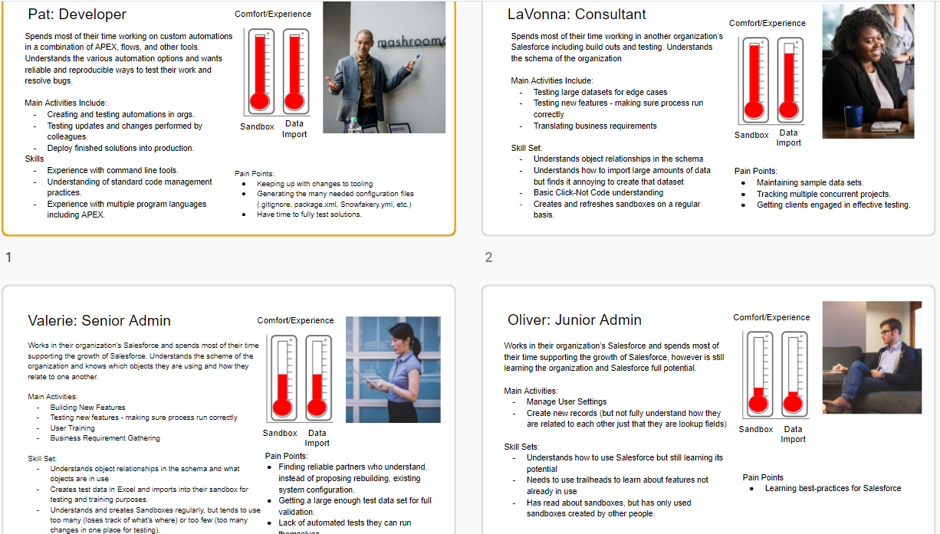
Personas - organize user stories into categories
Visit personas slides here
Notes:
Include some more specific research points for the team, such as your GitHub repo or existing documents.

Slide 10
Survey to understand community needs and competencies
Survey was administered from mid-July to mid-September. We have~75 responses.
Next step: Compile results and insights.
View responses
Notes:
Include some more specific research points for the team, such as your GitHub repo or existing documents.

Slide 11
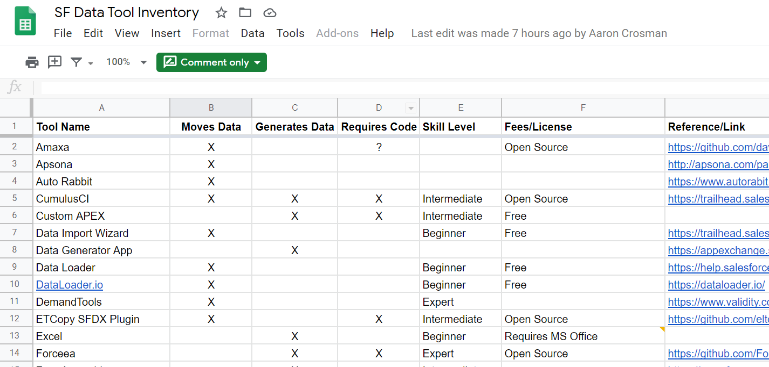
Tracking tools for Data Generation and Data Moving
Next step: Move to a new collaborative workspace; Start documenting.
View spreadsheet
Notes:
Include some more specific research points for the team, such as your GitHub repo or existing documents.

Slide 12

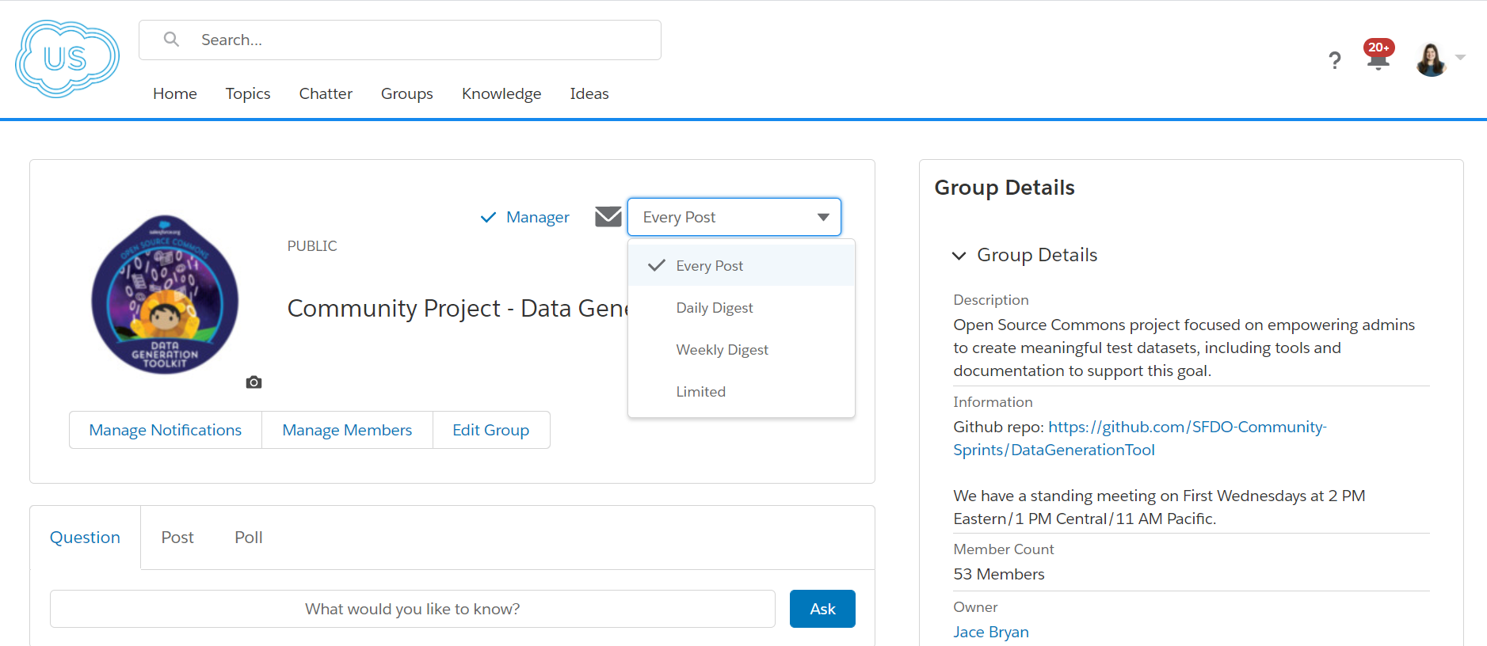
Join us in the Power of Us Hub and turn group notifications “on”
Notes:
Point your volunteers to your Power of Us Hub group and encourage them to get involved.

Slide 13

Sprint Projects - Documentation (Issue #12)
Project
Point person
Group members
Create documentation template/outline (priority) | Cassie | Rebecca, Michael Kolodner, Samantha
Use template to begin documenting tools and processes for Data Gen and Data Moving
Review CCI documentation and provide feedback
Notes:
If you’ve been able to pre-define some goals or objectives for the Sprint, detail them and the sub-group leader to help orient your Sprinters.

Slide 14
Sprint Projects - Tooling
Project
Point person
Group members
Requirements and wireframes for Snowfakery UI (priority) (Issue #4) | Aaron, Paul | Lawrence, Jung
Create Snowfakery “recipes” (Issue #1, 6, 8, 9)
Notes:
If you’ve been able to pre-define some goals or objectives for the Sprint, detail them and the sub-group leader to help orient your Sprinters.

Slide 15
Sprint Projects - Misc
Project
Point person
Group members
Analyze survey results (priority) | Rebecca | Deborah, Marciana
Document steps for using CCI to move NPSP Trial data from a Trial Org to a Sandbox
Notes:
If you’ve been able to pre-define some goals or objectives for the Sprint, detail them and the sub-group leader to help orient your Sprinters.

Slide 16
Sharing docs
Use THIS FOLDER to store docs in a central repository. We will later migrate them to our Github Repo.
Email leader@sprintsrock.com to request access.
Notes:
Keep everyone organized by providing them the location of all existing material. That location could be your GitHub repo, but at minimum should be linked to your repo for reference.

Slide 17
Use our editable graphic resources...
You can easily resize these resources without losing quality. To change the color, just ungroup the resource and click on the object you want to change. Then, click on the paint bucket and select the color you want. Group the resource again when you’re done. You can also look for more infographics on Slidesgo.

Slide 20
JANUARY
FEBRUARY
MARCH
APRIL
MAY
JUNE
PHASE 1
Task 1
Task 2
PHASE 2
Task 1
Task 2
JANUARY
FEBRUARY
MARCH
APRIL
PHASE 1
Task 1
Task 2

Slide 23
...and our sets of editable icons
You can resize these icons without losing quality.
You can change the stroke and fill color; just select the icon and click on the paint bucket/pen.
In Google Slides, you can also use Flaticon’s extension, allowing you to customize and add even more icons.

Slide 24
Educational Icons
Medical Icons

Slide 25
Business Icons
Teamwork Icons

Slide 26
Help & Support Icons
Avatar Icons

Slide 27
Creative Process Icons
Performing Arts Icons

Slide 28
Nature Icons

Slide 29
SEO & Marketing Icons

Slide 30


